Slide 1
Idaho BEAD
Post Award Changes (PAC) Bidding Round
IDAHO OFFICE OF BROADBAND
August 14, 2026

Slide 2


Agenda Topics
1
Purpose of the PAC Bidding Round
2
Timeline and Key Dates
3
Who May Participate
4
Eligible APAs and Available Locations
5
Application Process Walkthrough
6
Bidding Options & Required Documentation
7
Evaluation and Award Process
8
Post-Award Activities

Slide 3
*Consistent with prior Idaho BEAD Application Rounds
Purpose of the PAC Bidding Round
1
2
3
4
IOB is conducting a supplemental competitive selection process* allowing the remaining eligible locations to be awarded and included in Idaho’s final BEAD proposal.
Idaho remains committed to universal broadband coverage.
Previously awarded projects experienced partial or complete withdrawals.
Certain eligible locations are now available for rebidding.

Slide 4
Why a Simplified Process?
NTIA Compressed Timeline
  NTIA deadlines
  Need for expedited review
NTIA Requirements Remain Unchanged
  While simplified, the PAC process still requires complete and compliant submissions, including:
  25% match
  Tribal consent
  Speeds
  Letter of Credit or Performance Bond
  Per BSL High-Cost Threshold: $8,500 - $19,500
  Priority Project analysis

Slide 5
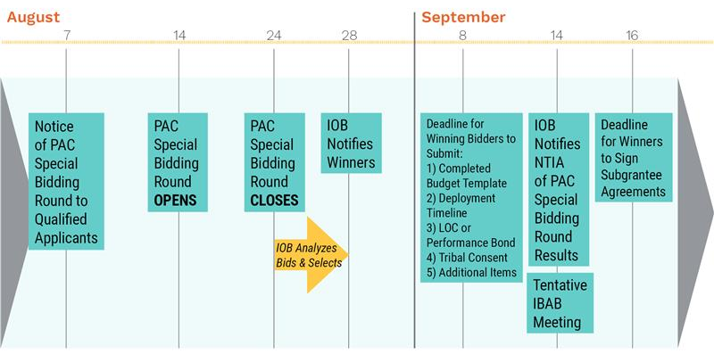
Anticipated Timeline & Overview of the Application Process
No extensions are anticipated.

Slide 6

Critical Timeline Requirement
No Curing Process
  Unlike previous rounds:
  ❌ No curing period
  ❌ No correction window
  ❌ No opportunity to supplement incomplete applications

Slide 7
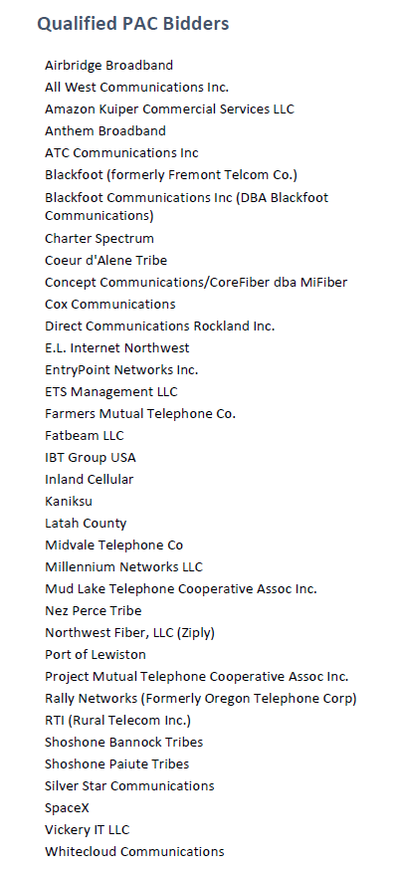
Who May Participate?
Eligible Applicants
Not Eligible
Previously approved Idaho BEAD prequalified applicants
Current Idaho BEAD subgrantees
Entities listed in Appendix A of the PAC Bidding Round Announcement
ISPs that did not complete the Idaho BEAD prequalification process
Applicants that were previously awarded BEAD-funded projects but later fully withdrew from the Idaho BEAD Program are not eligible to participate in this bidding round.

Slide 8
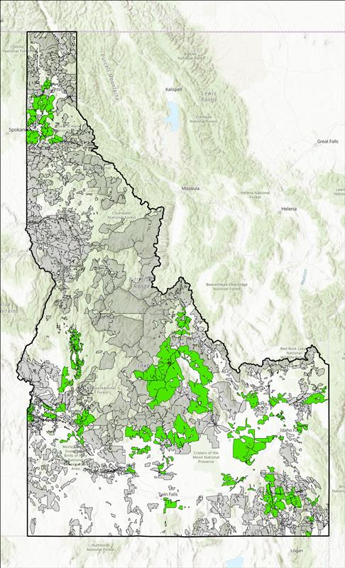
Updated Idaho BEAD Map
Eligible APAs and Available Locations
  Eligible APAs included in Tuesday’s communication
  Eligible APAs and BSLs:
  Entire APAs are available
  Partial APAs are available

Slide 9
Project Type Options*
Option 1
Expand Existing BEAD Project
Option 2
Create New Standalone Project
Option 1 Requirements
  Existing award updated
  Agreement amendment required
  Revised award and match amount
  Updated LOC or Performance Bond
Option 2 Requirements
  New NTIA project number
  New Subgrantee Agreement
  Separate project tracking
  Financial security requirements
*Subgrantee will choose the option with its Phase 2 submission

Slide 10
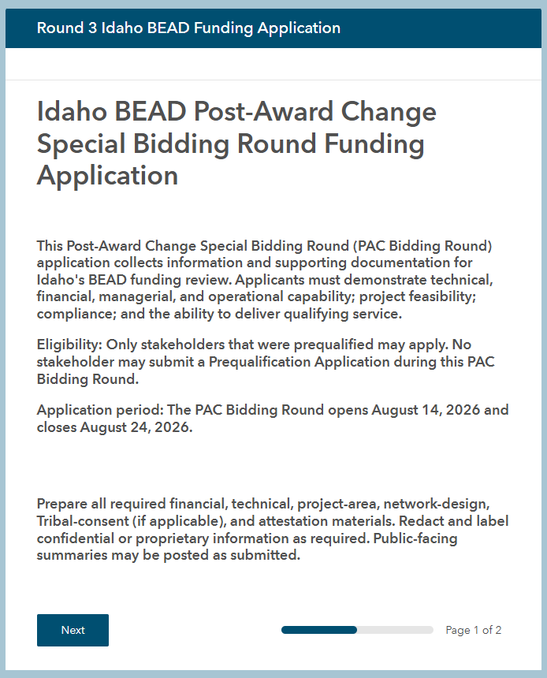
Official Intake Form: Survey 123
  Upload all required information to the official intake form!
Important
  Accessing the application form
  Project-level submissions
  Submission methodology
  Upload/Attachment requirements
  Application Submission Requirements
  All applicable project areas (APAs) included in the project
  All BSLs and CAIs included in the project
  Proposed technology type
  Proposed speed offering
  Proposed latency
  Network Design
  Scalability characteristics
  Total cost per BSL
  BEAD support amount requested
  Applicant’s match commitment
  Other technical data

Slide 11
Provide All Details Requested in Your Narratives
Brief Proposed Project Description
  APAs
  Number of eligible BLS to be served in the project
  Planned technology type
  Proposed Speeds
  Match Amount
  BEAD grant funds requested
Discuss Capacity of Funded Network
  Wireless networks must address plans to:
    Provide qualifying broadband service to all BSLs in the proposed project area
    Adopt wireless mitigation strategies
Discuss plans for Scalability and Expansion
  Anticipated costs beyond BEAD funded costs for future upgrades of equipment and network capability
Discuss How Network Will Scale Speeds Over Time
Explain how proposed network will easily scale speeds over time to meet evolving connectivity needs of households and businesses

Slide 12
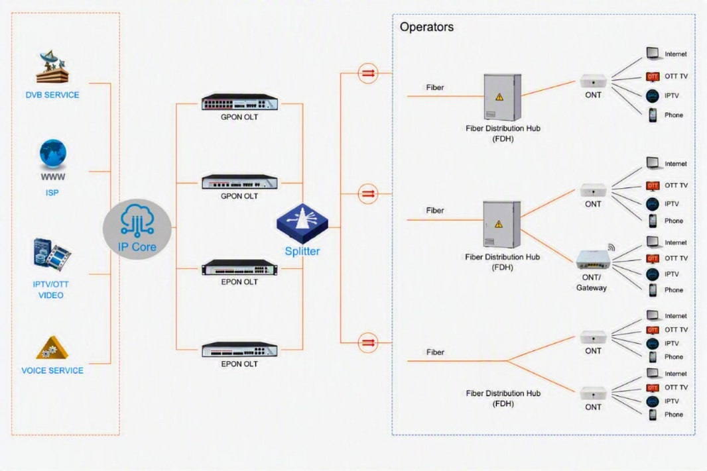
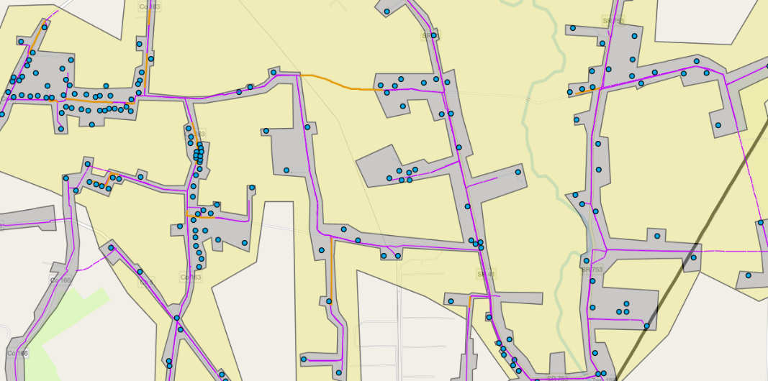
Network Design Requirements
Applicants Must Submit
  List all planned equipment types and major network protocols, including DOCSIS versions, optical fiber technology types (XGS-PON, G-PON, etc.), satellite technology, and customer premises equipment deployed in the funded network.
  Network Route Diagram: Upload a project area polygon and network route drawing in a shapefile or geospatial format (KMZ, etc.) that supports the committed technical performance and network capabilities.
  Logical Network Drawing: Upload a logical network design drawing or diagram in JPEG, PNG, or PDF format.
  Project Narratives (on previous slide)
Common Mistakes
  Missing files
  Incomplete designs
  Unsupported assumptions

Slide 13
Network Route Diagram
BEAD Program Funding Application Guidelines
Please include all of the following elements within the Network Route Diagram. Please be as specific as possible for the technology type and location of your project. Not all elements will apply to each technology type.
  The proposed project area, including APA boundaries shown as a polygon, and the BSLs to be served (depicted as points)
  Network infrastructure routes:
  Fiber or coaxial: Placement of fiber or coaxial routes, making distinctions between new and existing;
  Wireless: Placement of new and existing towers, making distinctions between new and existing, and modeled coverage area;
  Satellite: Placement of new and existing satellite ground equipment or stations, making a distinction between new and existing, and the area to be served by each station;
  If applicable, planned backhaul and middle-mile routes that will be constructed as part of the project, designating the technology for each
  Location of key elements such as outside plant placement of huts and central offices
The IOB reserves the right to require additional information regarding the proposed network’s ability to meet BEAD performance standards and may request additional types of evidence or documentation that required to support applicant’s claims.

Slide 14
Cost Information Requirements
Applicants Must Submit
    Total project cost
    Cost per BSL
    NTIA's excessive cost threshold will still apply:
    Funding cost per BSL between $8,500 - $19,500 will require justification
    Funding cost per BSL above $19,500 will not be accepted
    BEAD funding request
    Match commitment (Calculated automatically.)
Recommendations
    Validate calculations before submission
    Review consistency across forms

Slide 15
Subgrantee Agreement Attestation
Applicants Must Submit
  Signed attestation due with application
Important Reminder
  Applicants are not signing the subgrantee agreement in this phase.
  Applicants are agreeing to execute the agreement if selected.
  No agreement negotiations will occur through this process.

Slide 16
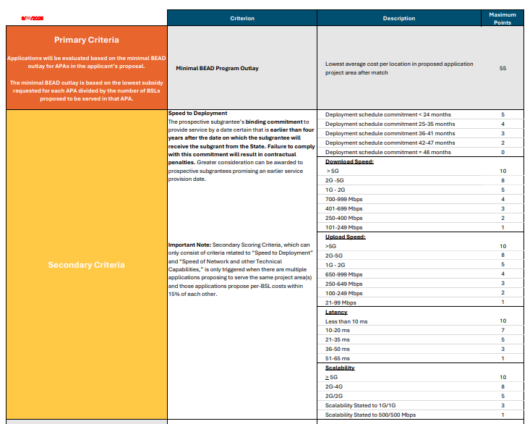
Evaluation & Award Process

Slide 17

What Happens After Selection?
Winning bidders will be notified by August 28, 2026, and will have
11 DAYS TO COMPLETE PHASE 2 and submit all required Subgrantee Agreement documents
Compressed Timeline for Required Applicant Documentation
  Project Pro Forma Template
  Project Budget Template
  Project Deployment Timeline Template
  Letter of Credit or Performance Bond*
  Estimated number of Jobs Created (new)
  Conflict of Interest Acknowledgment
  Tribal Consent (if applicable)
  Cybersecurity and Supply Chain Risk Management Attestation
  Protecting BEAD Program from Defaults Attestation
  Byrd Anti-Lobbying Amendment Certification
  Certificate of Insurance
Only needed if the subgrantee has not already submitted for another project.
*Performance Bonds are due within 60 days of SGA execution

Slide 18
Resources Available to Applicants
• PAC Bidding Round Announcement
• Idaho Scoring Matrix
• Subgrantee Agreement Template
• Idaho BEAD Map
• Final Round 3 APA/BSL Template
• Round 3 BSL and APA List
• PAC Bidding Round Attestation
• 1-on-1 Technical Assistance (as requested)
• Contact: IdahoBEAD@mbakerintl.com

